Slide 1
Group 3
IBVS, PBVS, Q-Learning using pybullet
Kushagra Agrawal B20296
Madhur Jajoo B20211
Vanshaj nathani B20237

Slide 2
Configuration
We used a car type husky robot with camera attached on top of it
We used an aruco marker to detect our desired position
Our camera is set to give images of 800*600 with FOV 90 and focal length 50.
For

Slide 3
IBVS
We find the marker and by the corner points as desired point we find the error using Jacobian and use it to calculate velocities.
The velocities for it keeps changing and moves the bot trying to lower error btw current position and desired position.

Slide 4
PVBS
We used depth camera to get distance from camera to marker.
We transformed the value first into robot frame from camera frame and then to world frame using focal length of 50.
After getting desired coordinates in world frame we moved the robot to that point.

Slide 5
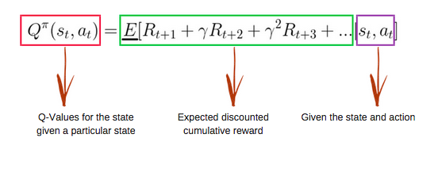
Q-Learning
We have defined the reward of goal point where the agent needs to go.
The reward of goal point is set as 1000 and the reward of all other points as -1, so the code simulates to get the maximum reward as output.

Slide 6
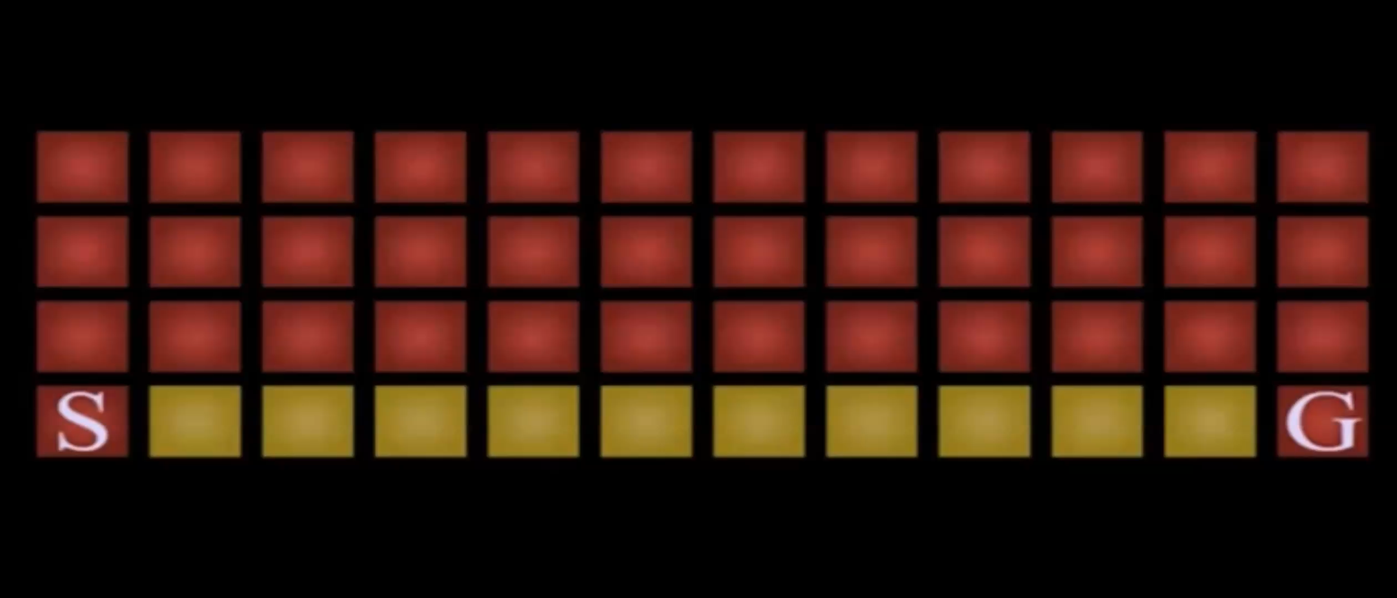
Q-Learning

